Slide 1
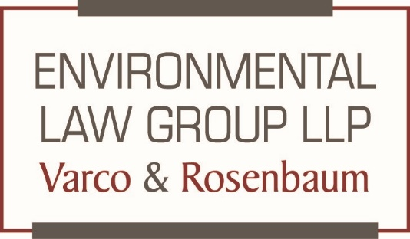
Storm Water/Prop 65 Regulatory Update
SDEP Luncheon
May 4, 2022
S. Wayne Rosenbaum
Environmental Law Group

Slide 2

Recent Hot Topic Highlights
Storm Water
  General Construction Storm Water Permit
  Commercial/Industrial/Institutional Storm Water Permit
Proposition 65
  Short Form Warning
  PFAS

Slide 3

General Construction Storm Water Permit (CGP) --Status
Current Permit
  Last issued 2010
  Became effective 2011
Proposed Permit
  Projected issue date July 2022
  Proposed effective date
    Currently enrolled projects July 1, 2025
    New Projects July 1, 2023
Enforceable by Citizen Suit

Slide 4

CGP Major Changes
NALs vs. NELs
Nonvisible pollutants
Use of flocculants
Role of QSD and QSP

Slide 5


NALs and NELs
Permit proposes Numeric Action Levels (NALs) and Numeric and Numeric Action Levels (NELs) for “Non-visible” pollutants.
NALs
  Triggers for additional BMPs.
  Not themselves a violation
  Failure to address NAL exceedances is a violation
  Unclear as to how or when NALs are triggered.
NELs
  Exceedances are permit violations
  Mandatory minimum penalties
  Unclear as to how or when a NEL is determined to be exceeded

Slide 6


Non-Visible Pollutants
Non-visible pollutants include dissolved metals, nutrients, and pesticides
  Example Chollas Creek
Exceedances of NALs or NELs for non-visible pollutants triggers enforcement.
  Iron 0.3 mg/L
  Phosphorous 0.1 mg/L
Permit requires sampling for Non-Visible pollutants when there is a BMP:
  Breach
  Failure
  Malfunction
Beach, Failure and Malfunction are undefined terms
No compliance storm
  Permit does not provide any exception for storm events that exceed the design storm

Slide 7

Flocculants
Permit proposes to use TSS as a surrogate for some non-visible pollutants.
Flocculants are a BMP that helps control sediment and non-visible pollutants associated with sediment.
Permit strictly limits the type of flocculants that can be used and under what conditions.
Increase likelihood of an exceedance of a NEL or NAL in the event of a breach, failure or malfunction of a BMP.

Slide 8

QSD and QSP
The Qualified SWPPP Developer (QSD) is responsible for preparation of the SWPPP and monitoring plan.
  Generally, a civil engineer but not always
The Qualified Storm Water Professional (QSP) is responsible for implementation of the SWPPP and monitoring plan.
New Permit significantly expands QSP and QSD roles and responsibilities
  Significant increase in project costs
  Significant additional liabilities for the QSD and QSP.

Slide 9
Commercial Industrial and Institutional(CII) Permit
Background
Who will be regulated
How will they be regulated
Procedural Status
Next Steps

Slide 10

CII Background
Arises out of Citizen Suit litigation from 2018
Plaintiffs petitioned EPA to a make a determination that unpermitted stormwater discharges from privately-owned commercial, industrial, and institutional (“CII”) sources at two different Los Angeles area watersheds are contributing to violations of water quality standards in the watersheds, and therefore CII sources must obtain a NPDES permit.
EPA denied the petition.
Although EPA found that stormwater discharges from CII sources were “‘contributing to water quality impairments’ at the watersheds,” EPA determined that NPDES permits were not necessary because “existing programs are underway to adequately address the impairments,” such as California’s municipal separate storm sewer system permits. Order at 4-5.
In plaintiffs’ ensuing lawsuit, the District Court granted plaintiffs’ motion for summary judgment, concluding that “EPA acted arbitrarily and capriciously in denying Plaintiffs’ permits and leaving the stormwater discharges at issue unregulated.” Los Angeles Waterkeeper, et al. v. Pruitt, et al., Case No. 2:17-CV-03454-SVW-KS (C.D. Cal., issued Aug. 9, 2018).
The Court determined that EPA was either required to prohibit the discharge or regulate the discharge subject to the NPDES permitting scheme. . Los Angeles Waterkeeper, et al. v. Pruitt, et al., Case No. 2:17-CV-03454-SVW-KS (C.D. Cal., issued Aug. 9, 2018).
EPA and the Los Ageless Water Quality Control Board are in the process of drafting the CII permit

Slide 11
Who will be regulated under the CII Permit
Facilities located in Los Angeles and Ventura Counties that discharge to either the Dominguez Channel/Greater Los Angeles and Long Beach Harbor Watershed or the Los Cerritos Channel/Alamitos Bay Watershed.
Industrial, Commercial and Institutional Facilities
  Over five acres in size
  “Private” facilities

Slide 12
How will CII facilities be regulated
Three compliance options
  Direct compliance with NELs through sampling of stormwater runoff
  On-site stormwater retention of all 85th percentile storm events
  Off-site stormwater retention through agreement with a local watershed to help fund watershed management program
CII Permit will preempt and replace IGP coverage
CII Permit is fenceline to fenceline
Unanswered Questions
  How to define “public” versus “private” facilities?
    Private lessee on public land?
  Will the permit run to the “operator” or the “property owner?
    Each lessee in a shopping center or the landlord?

Slide 13
CII Procedural Status
CII is still being drafted by LA RWQCB and EPA
Permit will be adopted by the LA RWQCB
EPA and LA RWQCB indicate draft permit will be made public in the “spring”
Timing and process for permit review and adoption by LA RWQCB still unclear.

Slide 14

Where is the CII Going?
Citizen Suit enforcers are lobbing the legislature to apply the CII statewide.
State legislature and the SWRCB can not adopt an NPDES permit without EPA first using its residual authority.
Without NPDES status there is no basis for citizen suit enforcement under Porter Cologne.

Slide 15

Prop 65 Short Form Warning
In August 2016 the California Office of Environmental Health Hazard Assessment (“OEHHA”) adopted amended regulations for the provision of “clear and reasonable” Proposition 65 warnings in Title 27, California Code of Regulations, section 25600, et seq (“Warning”).
The amended regulations provided for the use of a “short form” warning.
Short form warnings have limited language and do not require the identification of a chemical of concern.
The 2016 did not limit the use of the short form warning to specific classes of products or product size.

Slide 16

OEHHA seeks to amend the regulations for the Short Form Warning
January 8, 2021, OEHHA issues a proposed amendment to the regulations regarding attempting to limit the use of the short form warning including.
  Label and package shape and size
  Font size
  Declarative statement “exposes you to”
OEHHA receives significant pushback from manufactures and retailers.

Slide 17
OEHHA seeks to amend the amendment
April 5, 2022, OEHHA publishes a revised rule with the following changes
  Use of the phrase CA Warning or California Warning
  Short form can be used on product labels of any size, regardless of package size and shape.
  Remove requirement that the warning must be in the same size font as any other consumer information
    6 point minimum
  Reverts to “can expose you to”
  Two years to implement after adoption
  Still requires inclusion of an identified chemical of concern.

Slide 18
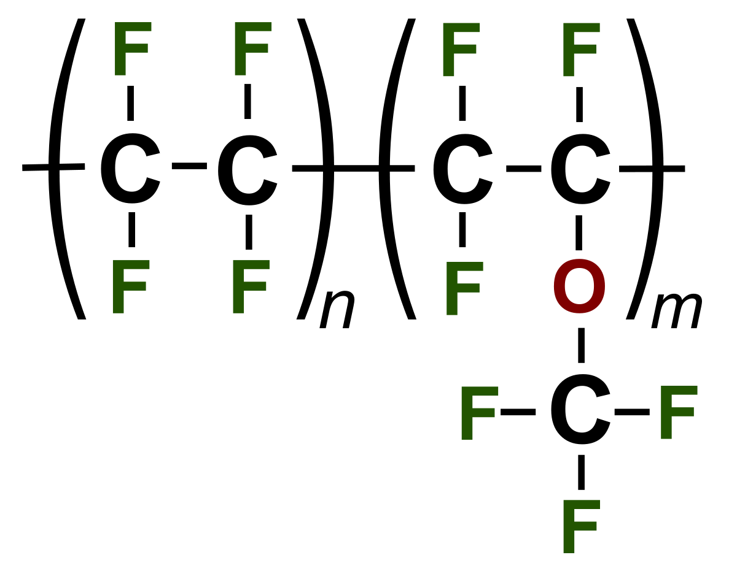
PFAS – The Forever Chemicals
They ARE EVERYWHERE
  CLOTHING
  pIZZA BOXES
  cHROME pLATING
  hYDROPHILIC APPLICATIONS
  rELEASE APPLCIATIONS

Slide 19
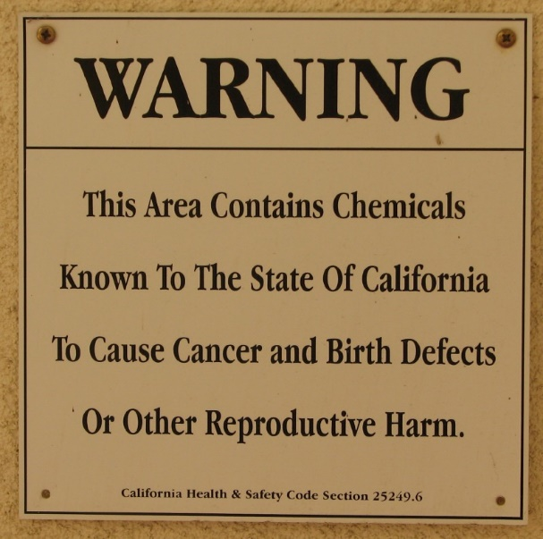
Proposition 65 Regulation
PFOA and PFOS listed as a Carcinogen in November 2017
  Warning Provisions Effective November 2018
    Consumer Product Warnings
    Environmental Exposure Warnings
    Occupational Exposure Warnings
    Tennant Warnings
  As of July 2019, California businesses were also to be prohibited from releasing PFOA or PFOS into sources of drinking water.
  Proposition 65 is enforceable by Citizen Suit

Slide 20

Recent Litigation
PFOA in Paper Straws.
  Five (5) PROP 65 Notices alleged that PFOA contents in paper straws required a Prop. 65 warning label.

Slide 21

Questions?

