Slide 1



Slide 2
SASEA believes...
All children, and their families, have the right to feel safe at school regardless of their neighborhood, background, or financial status
Notes:
SASEA believes that children and families have the right to feel safe at school, regardless of where they live, their background, or their financial status.

Slide 3
Project Aims
Determine real-world effectiveness of wastewater and surface monitoring early alert system for K-12 sites
Develop best-practice implementation protocols for long-term sustainability
Notes:
Using multiple data sources: Diagnostic testing, wastewater robots, surface sampling, household surveys, focus groups.

Slide 4
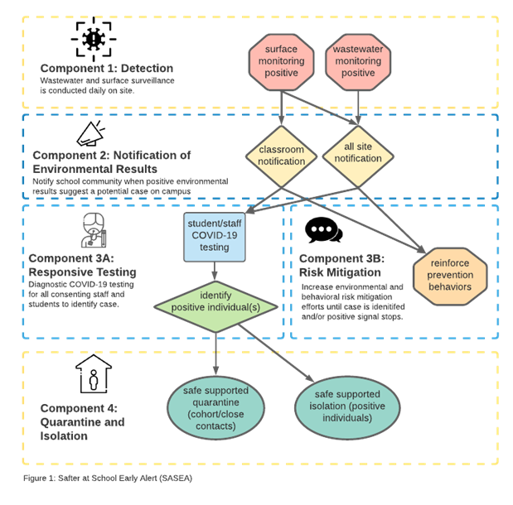
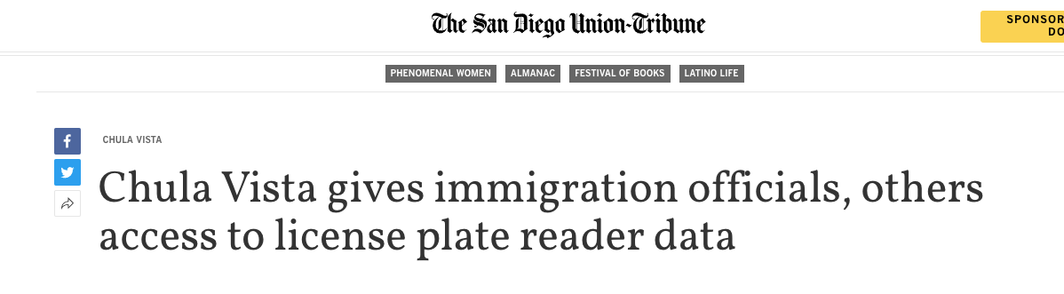
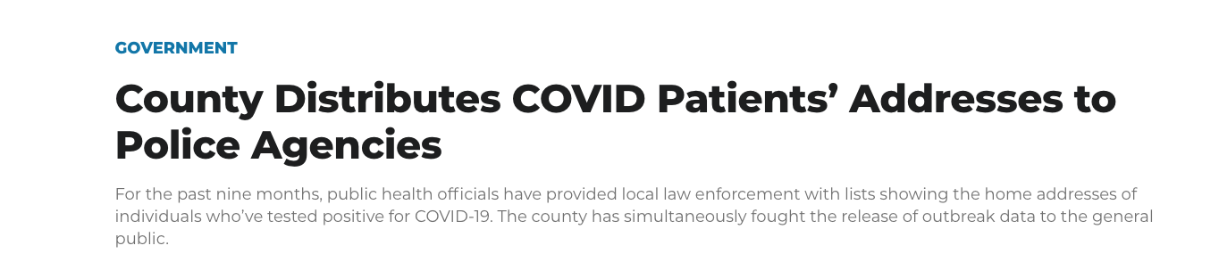
Mitigate risk by identifying cases before they become outbreaks
Provide data for targeted, as needed responsive testing
Alert schools to the need for more intensive risk mitigation measures
Neighborhood level sentinel surveillance for communities with the highest health disparities.
Notes:
Holistic system that requires buy-in or it doesn’t work.
Also, we don’t’ say ‘surveillance’ we say monitoring
We understand and respect all the reasons people might not want to test. In CA/border region there is a history of ‘broken promises’ with data and LEOs.

Slide 5
“I know a lot of our families have mistrust of like, authoritarian figures, that’s, because, you know, perhaps they're not here legally, or perhaps they have other things to hide.”
-Staff FGD participant
“There are many reasons why [...] especially our families would shy away from, like being talked to by somebody that they don't necessarily know, or are already on the fence about what their role is in their lives, right? So I think at the very least, if there is a situation where somebody has gone through this, that having the ability to [...] have myself or my principal, be involved with that [...] portion of the situation would be significantly more useful and helpful.”
-Staff FGD participant

Slide 6
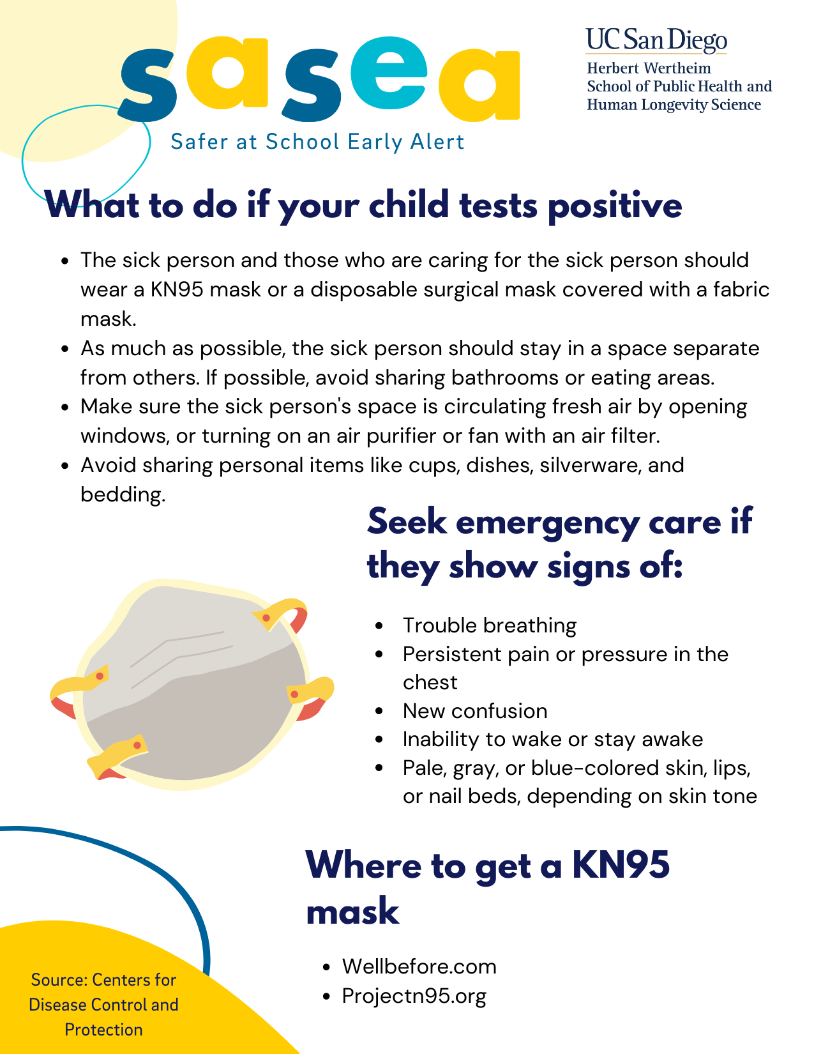
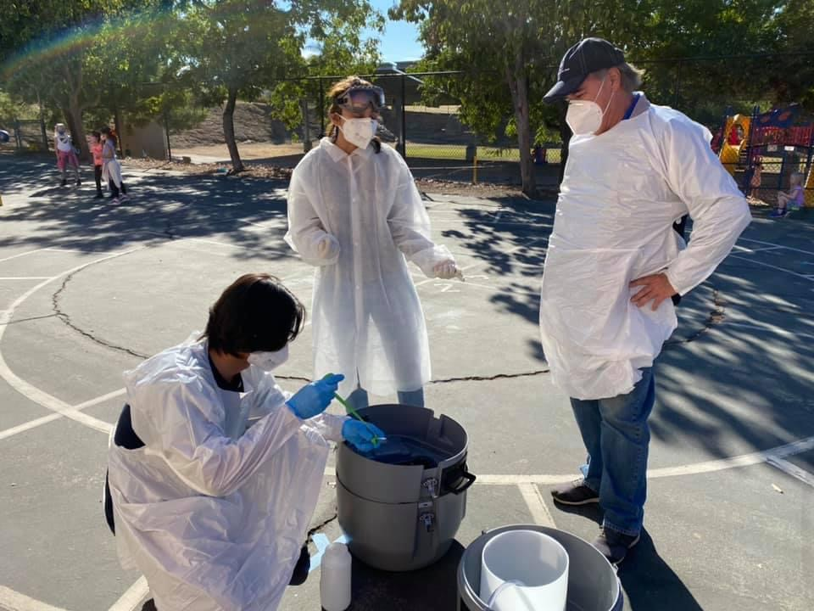
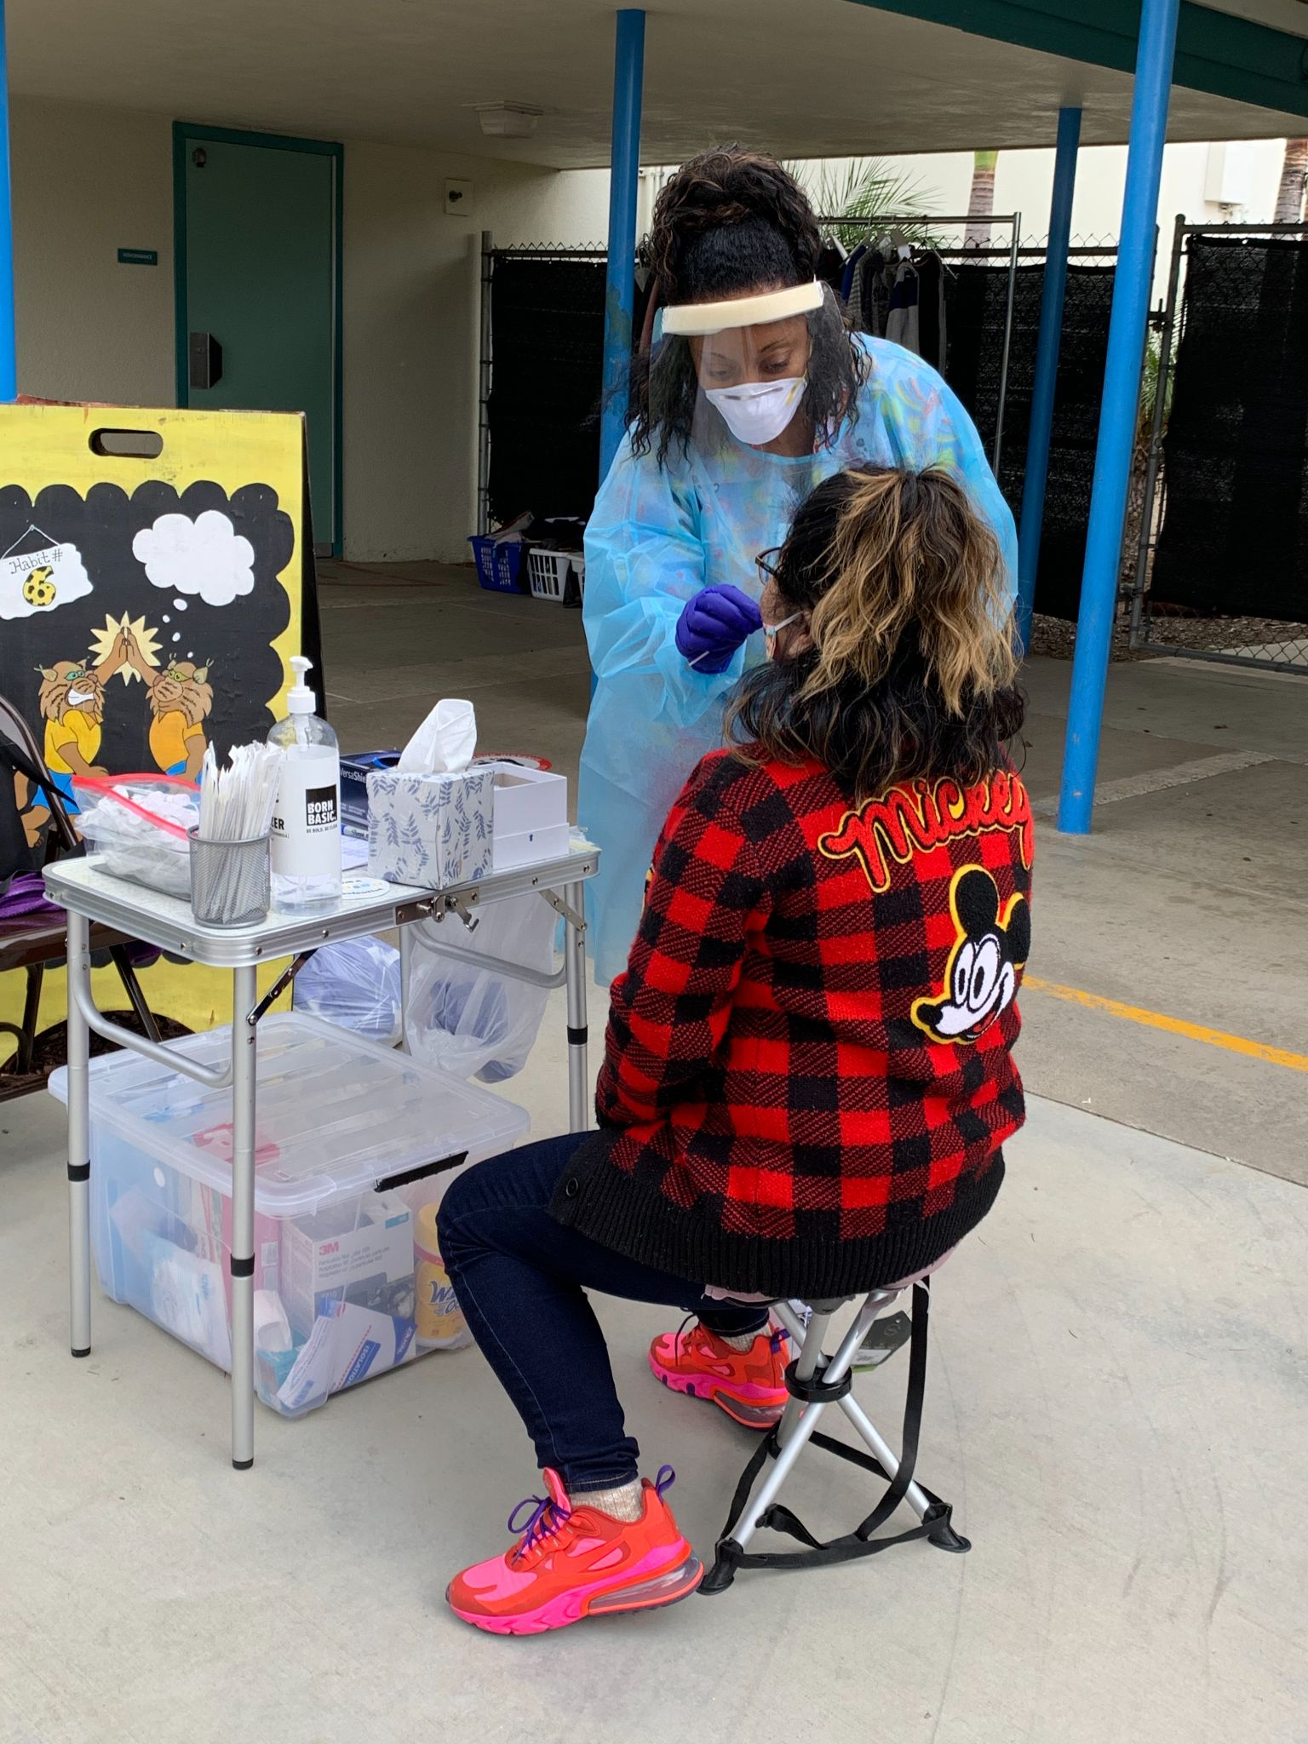
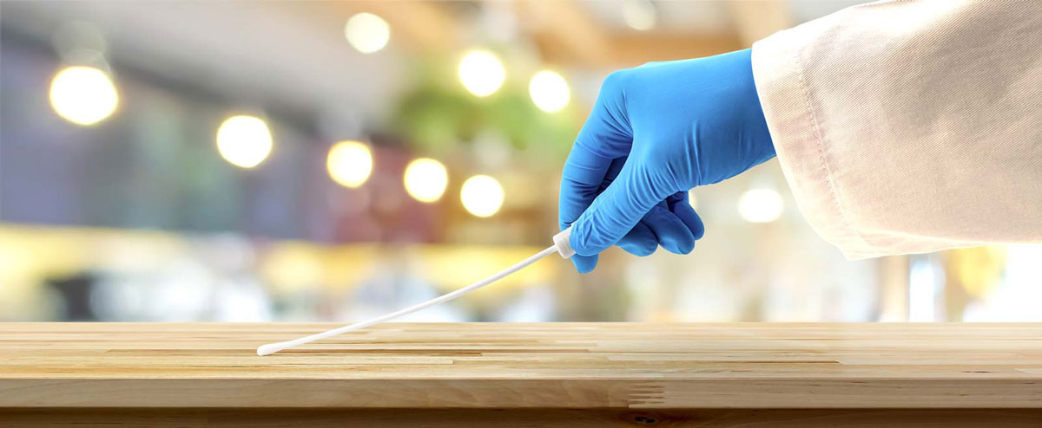
Notes:
Here are some images to help you visualize the 4 components I’ve listed earlier.
In the picture on the top left, we have our team collecting wastewater samples from the robot at a school site. The samples get sent to a lab that tests the sewer water for covid.
The picture on the bottom left is an example of someone wearing PPE and collecting a surface sample from a desk. After swabbing, the Qtip gets put in a test tube and sent to a lab that tests the sample for covid.
The picture in the middle is an example of our pop up testing station at a school site. When a site gets a positive environmental signal, a team of medical professionals will come on site with their mobile testing stations to conduct testing.
On the far right, we have an example of a flyer informing parents what to do when their child tests positive.

Slide 7
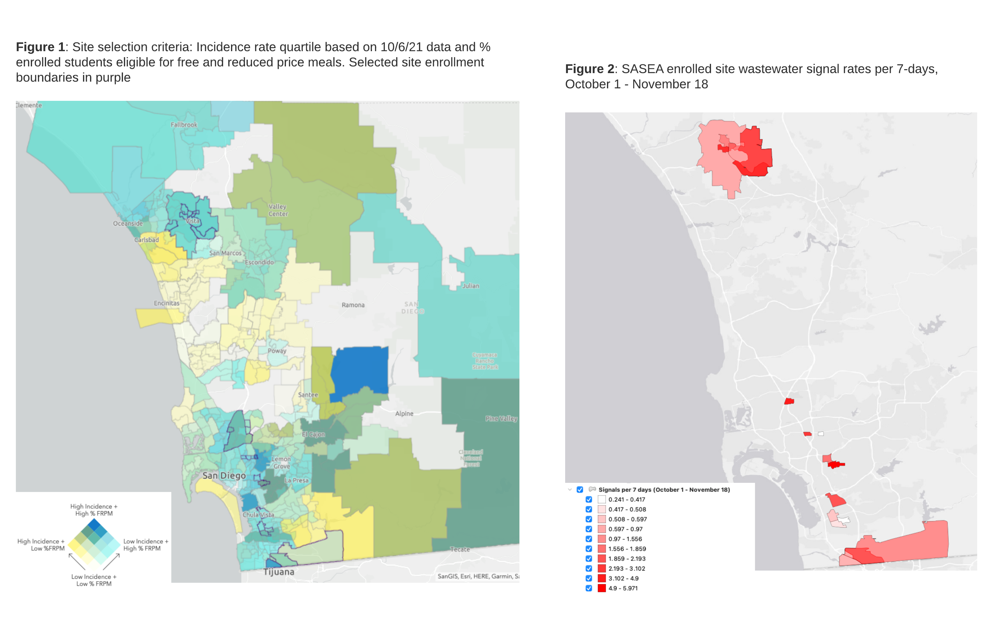
Community level monitoring

Slide 8
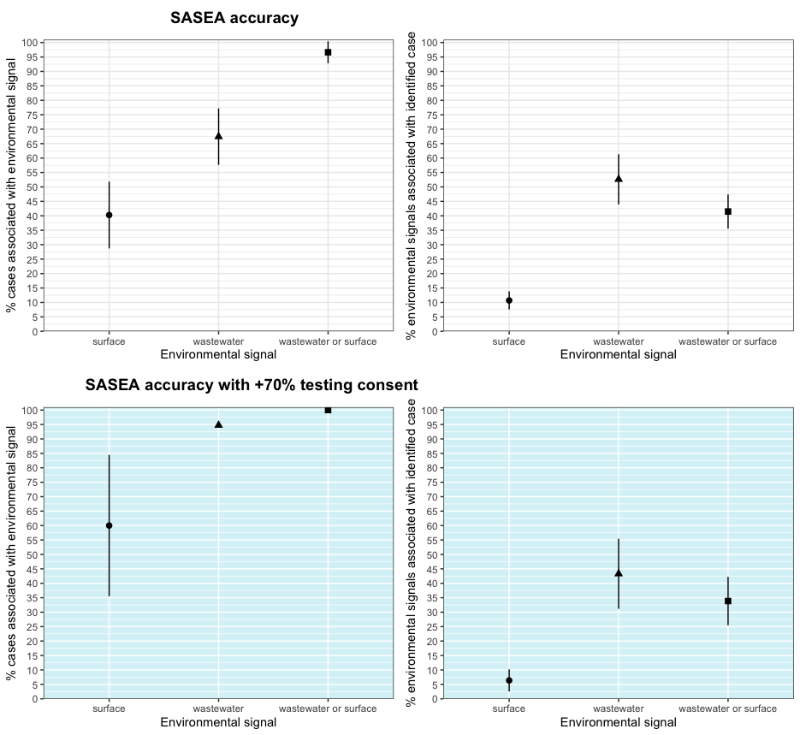

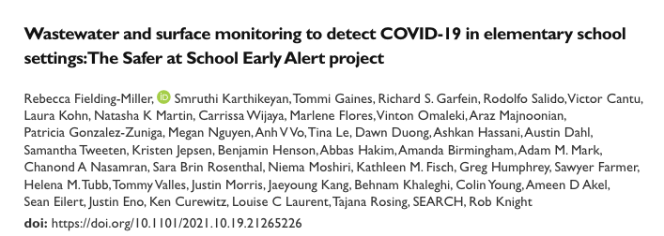

Slide 9
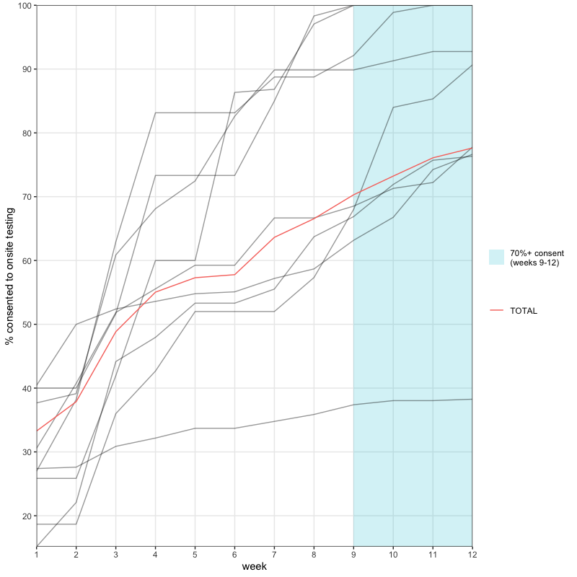
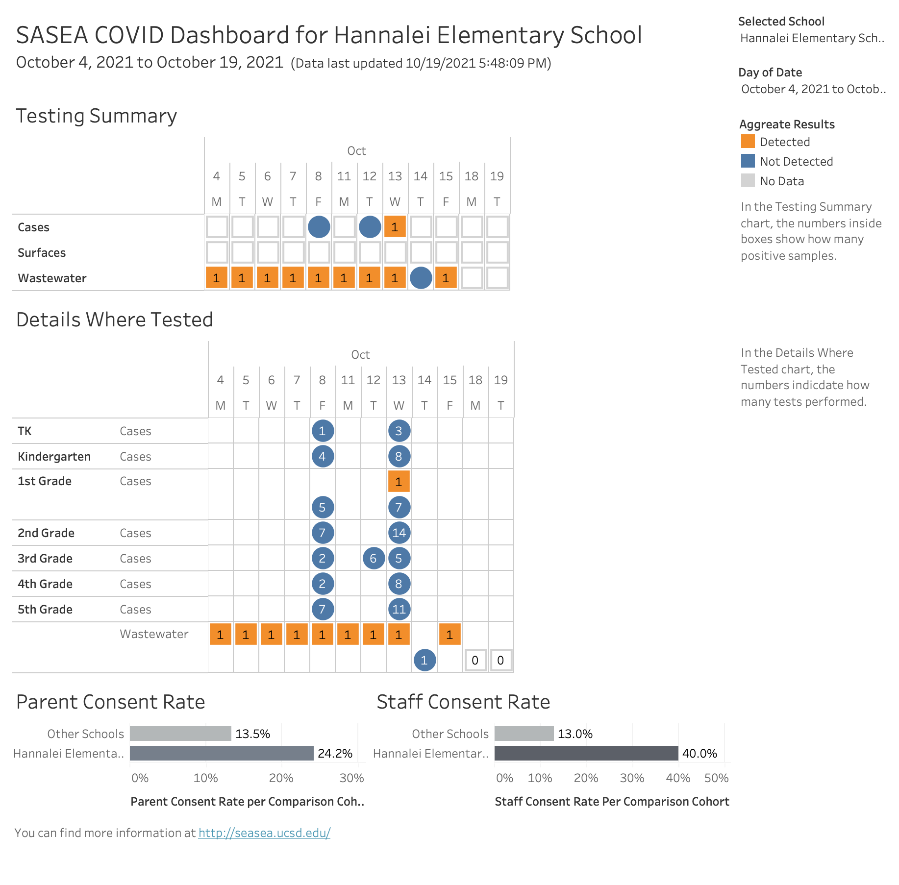

Slide 10
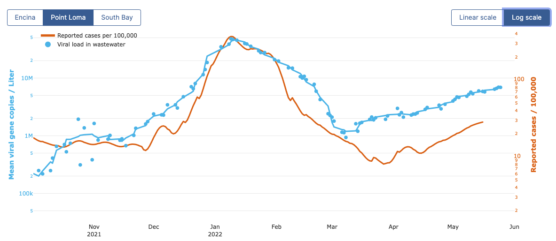

Slide 11
Engagement
Reminder emails from Principals
Town halls
SASEA stickers
Updates about wastewater & Surface sample results

Slide 12
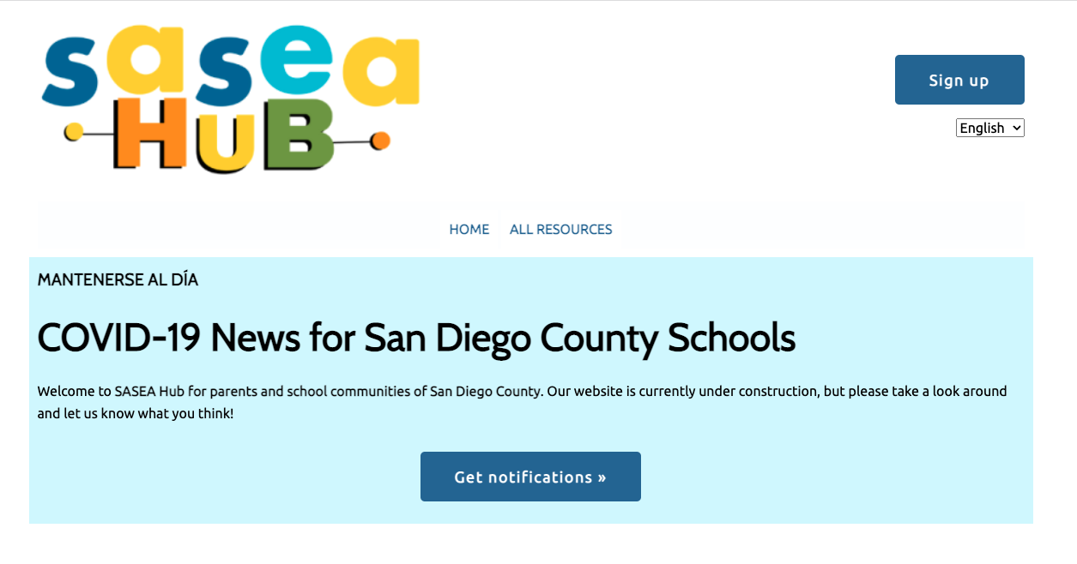
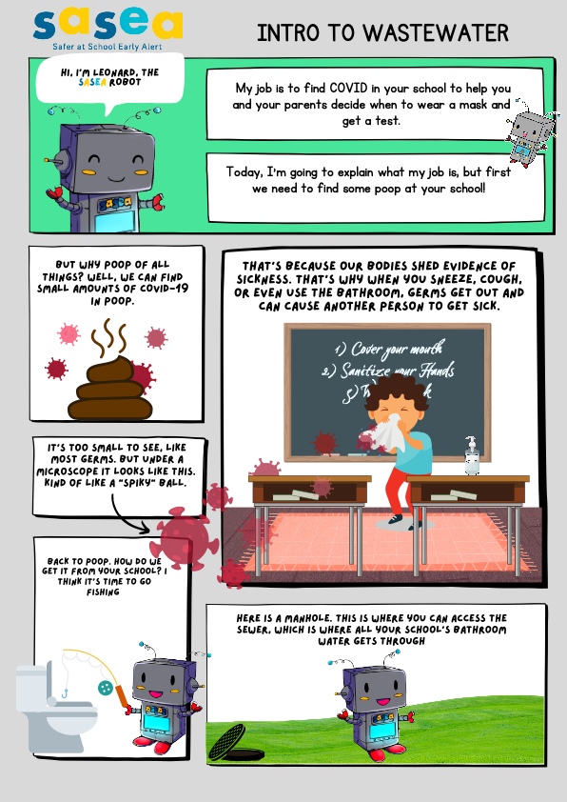
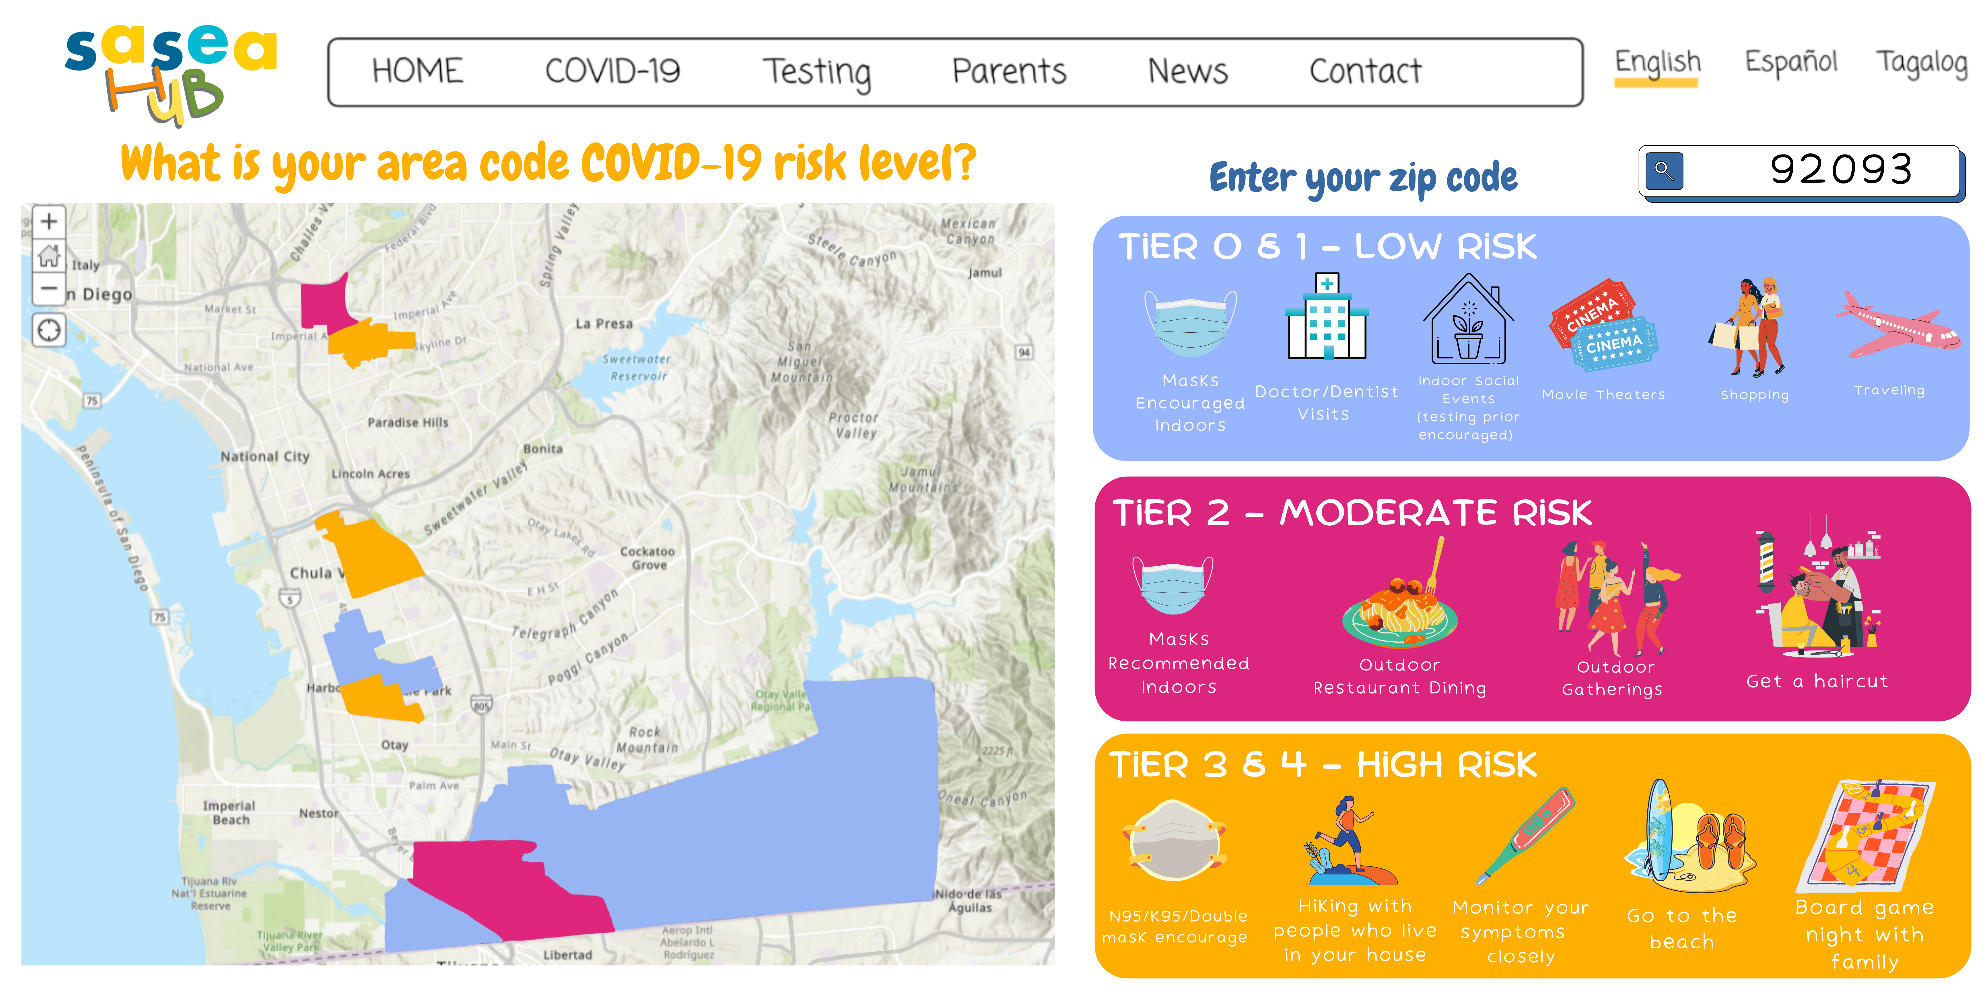

Slide 13
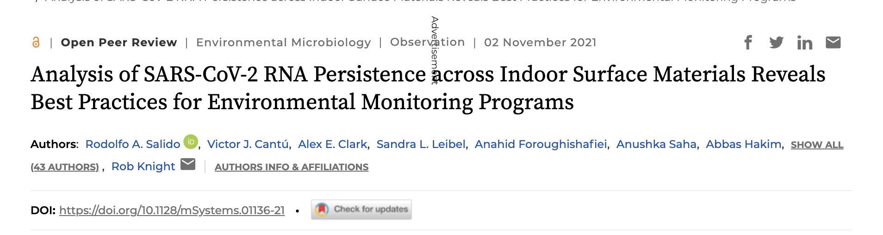
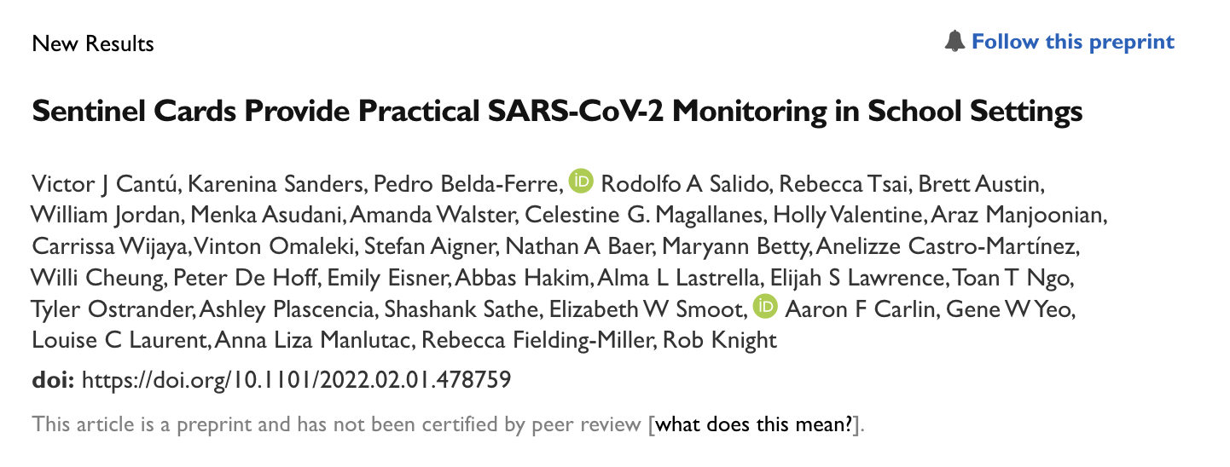

Slide 14
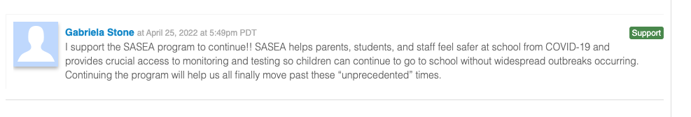
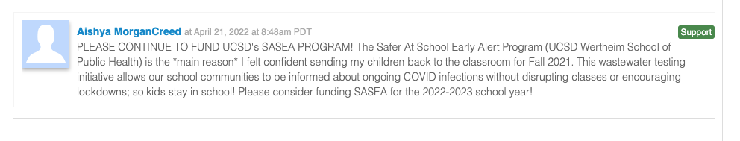
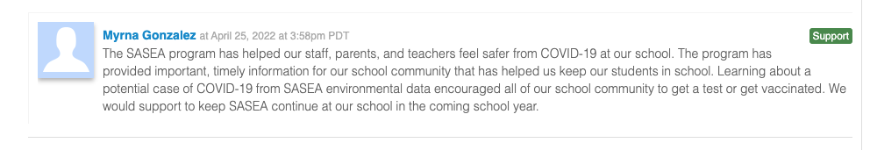
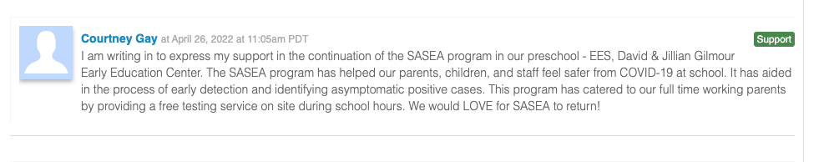
Notes:
What comes next – all the things people have talked about so far open up exciting opportunities to consider how else we can use these techniques to keep kids safer at school. Nutrition, environmental pollutants, stress/trauma. Working with our CAB to understand what communities want.

Slide 15
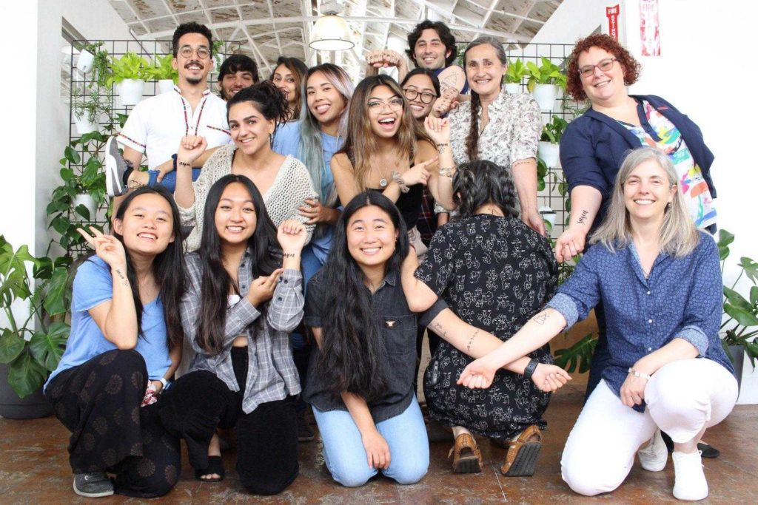
Reach out to us any time with questions, comments, and suggestions!
rfieldingmiller@health.ucsd.edu
sasea@health.ucsd.edu

