Slide 1
Full Scale In-Situ Gaseous Reduction of Hexavalent Chromium in Vadose Zone Soils with H₂S Gas
Brian Hitchens, PG, CHG, RG,
Chad Bird, PE, and Kirk Craig, PE

Slide 2
Introduction
In-Situ Gaseous Reduction for CrVI is a new approach to address a common issue
First applied in 1998 at the White Sands Missile Range as a cooperative DOE/DOD pilot study
The approach has significant benefits including:
Improved distribution through vadose zone soils as compared to liquid reductants
Rapid reaction and treatment times
Reduced potential for mobilizing CrVI to groundwater
Significant drawbacks include safety considerations during implementation

Slide 3
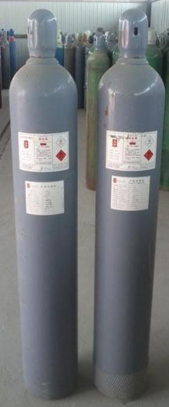
Introduction
Theory and historical testing of In-Situ Gaseous Reduction concept
Full scale case study implementation
Considerations for future applications

Slide 4
ISGR Chemistry
The stoichiometric equation for the volume of H₂S required to reduce CrVI to CrIII is:
0.375 moles of H₂S to reduce 1 mole of CrVI to CrIII
Approximately 4 mg H₂S per mg CrVI on a mass/mass basis (perfect reaction with no competing H₂S sinks)
Catalytic effects in the soil matrix may greatly accelerate oxidation of H₂S:
8CrO4²⁻ + 3H₂S + 10H⁺ + 4H₂O → 8Cr(OH)³ + 3SO₄²⁻
H₂S + 2O₂ → SO₄²⁻ + 2H⁺

Slide 5
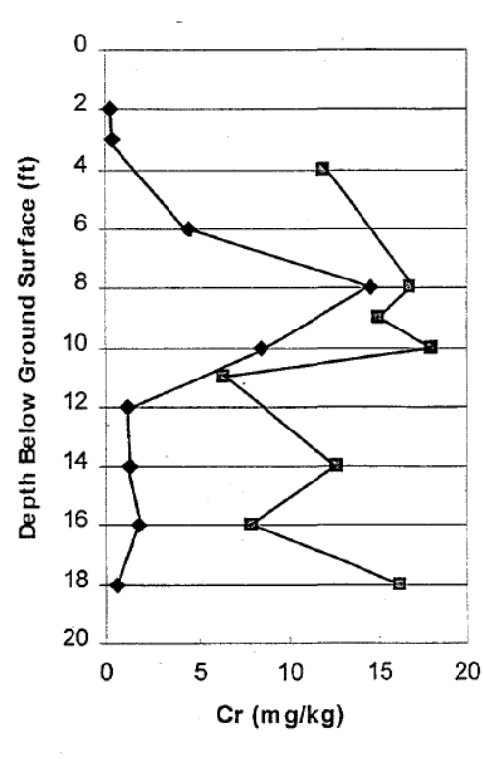
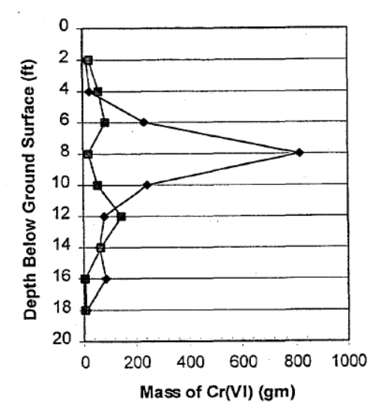
Historical Pilot Study
1998 White Sands Pilot Test:
Targeted a 10’ ROI to 18’ BGS
Sand to silty-sand lithology
200 ppmv injection concentration
35’ x 35’ hypalon cover placed over injection site to reduce vertical migration of gas
Operated for 10 weeks
Treatability study: 4x10⁻⁵ lb H₂S/lb soil
Pilot scale: 6.6x10⁻⁵ lb H₂S/lb soil

Slide 6
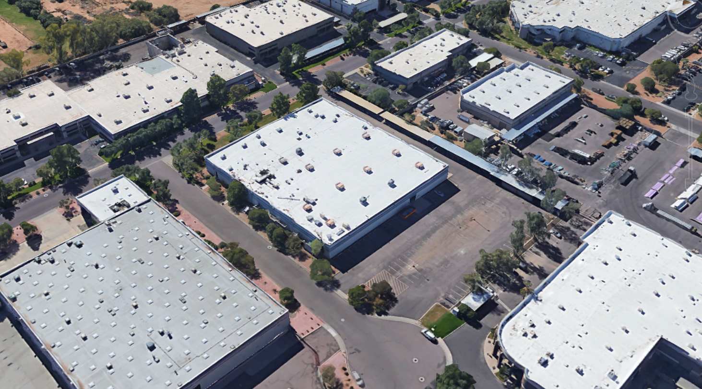
Project Case Study

Slide 7
Site Background
Aerospace Manufacturing Facility
10 years of plating operations
Initial characterization showed cadmium and CrVI impacts in soils beneath plating lines
Void in spill conveyance trench identified adjacent to external wall of building
Runoff from exterior roof drain downspout increased depth of impacts in CrVI area
Depth to Groundwater - ~100 feet
Lithology: intermixed gravel, cobbles, and silt

Slide 8
Project Goals
Fast remediation timeline for sale of property, 1 year for:
Enrollment in VRP
Complete characterization
Work-plan development
Bench scale testing
Permitting
Full scale implementation
Reporting
No Further Action determination
Constraints:
Building must remain standing
No deed restrictions (or long-term monitoring)
Soils should meet residential screening goals

Slide 9
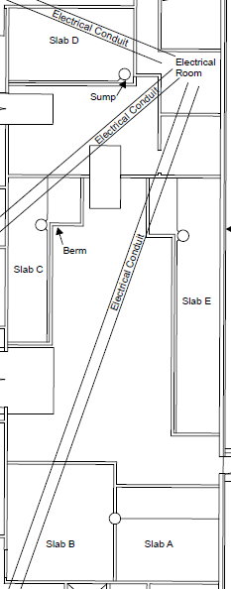
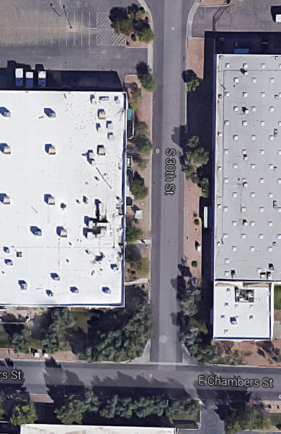
Extent of Impacts
Hexavalent Chromium and Cadmium
Three impacted areas identified
Northern area: Cadmium impacts to 7 ft bgs
Southern area:
Cr⁶⁺ impacts to 95 ft bgs (up to 7800 mg/kg)
Above rSRLs (30 mg/kg) to 45 ft bgs
No groundwater impacts
Alternatives Evaluated:
Excavation
Immobilization
In-Situ Reduction
In-Situ Gaseous Reduction

Slide 10
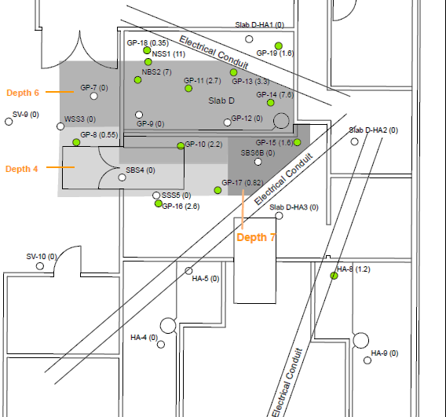
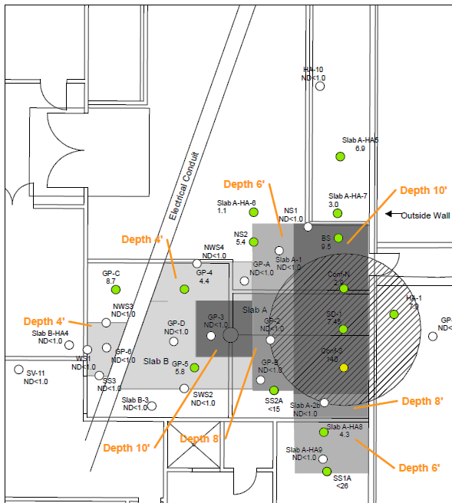
Remedial Design
Shallow Excavation of impacts to 10’
ISGR of deeper CrVI impact above residential soil screening levels (30 mg/kg)
All cadmium impacts were within the top 7-feet of soil
Deep CrVI impacts constrained to a small area near the suspected release point
ISGR area backfilled with 1-foot of hydrated bentonite prior to backfill

Slide 11
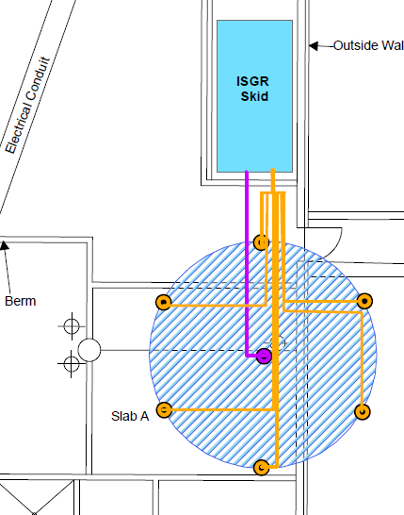
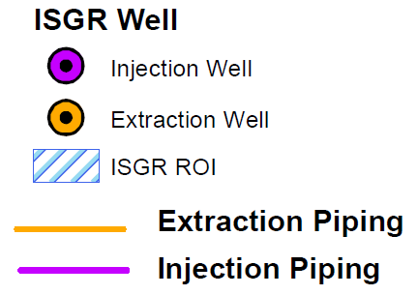
Injection Design
ISGR treatment interval from 10-45’ BGS
Focus on a safe, efficient, uniform distribution of H₂S gas in treatment interval
10-Foot radius of influence
Injection well with three, nested10-foot well screens
Extraction wells with single 35-foot well screens

Slide 12
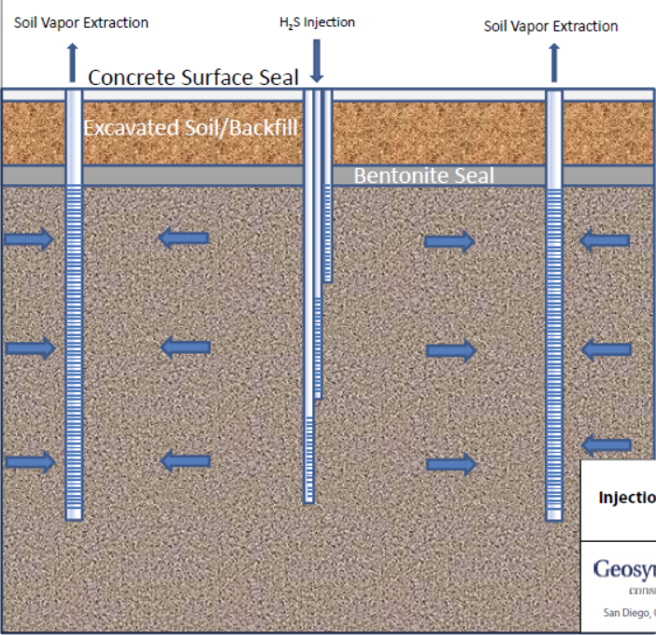
Well Design
10
20
30
40

Slide 13
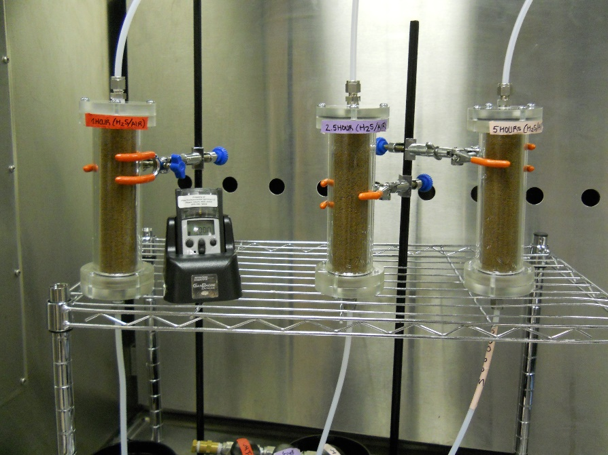
Bench Scale Testing
Bench scale test:
Passed H₂S gas through
columns of homogenized soil
Evaluated H₂S concentrations
and exposure duration
Calculated mass H₂S/mass soil
treated
Results
Recommended concentration of 400 ppm
Injected at 60 cfm
For 16 weeks of injection

Slide 14
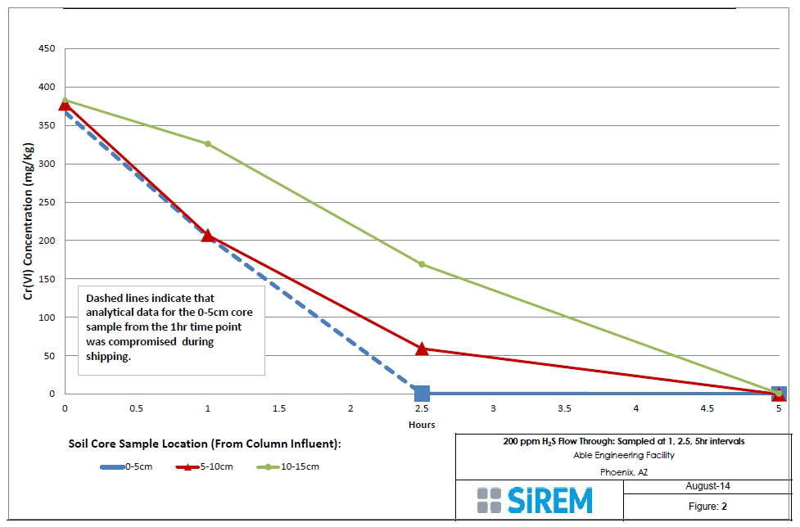
200 ppm H₂S Bench Study Results

Slide 15
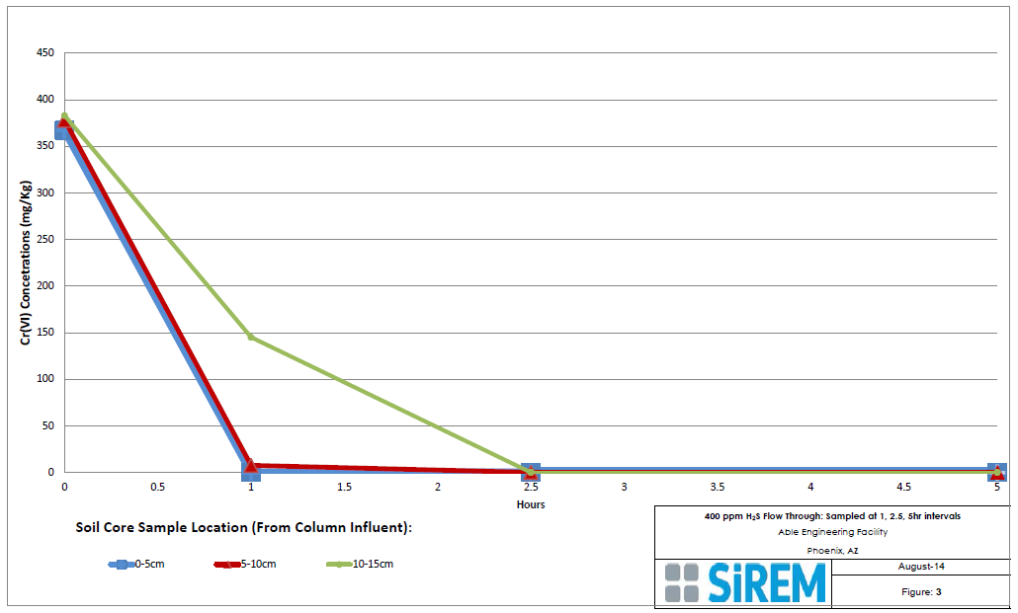
400 ppm H₂S Bench Study Results

Slide 16
Calculation of H₂S Dosing
Observed efficiency was ~3.7x – 5.0x theoretical requirement.
Did not collect data on H₂S breakthrough from soil columns, cannot say if the observed efficiency is due to unused H₂S passing through column, or oxidation of H₂S. We will include this evaluation in future bench-tests.
Calculated volume of H₂S for application was based on mass of SOIL in treatment area with assumed average CrVI concentration of 376 mg/kg
Recommended dosage: 340 mg H₂S/Kg soil.
Goal: Apply 780 kg H₂S evenly throughout 340 cubic yards of treatment area
Safely

Slide 17
How Fast To Apply?
Higher application concentrations and flow rates reduce treatment time, but increase risk:
Leaks
Inefficient application (breakthrough of unreacted H₂S)
Target rate is 90 CFM injection at 500 ppm H₂S, 120 CFM extraction
Injection time: 9 weeks (continuous)

Slide 18
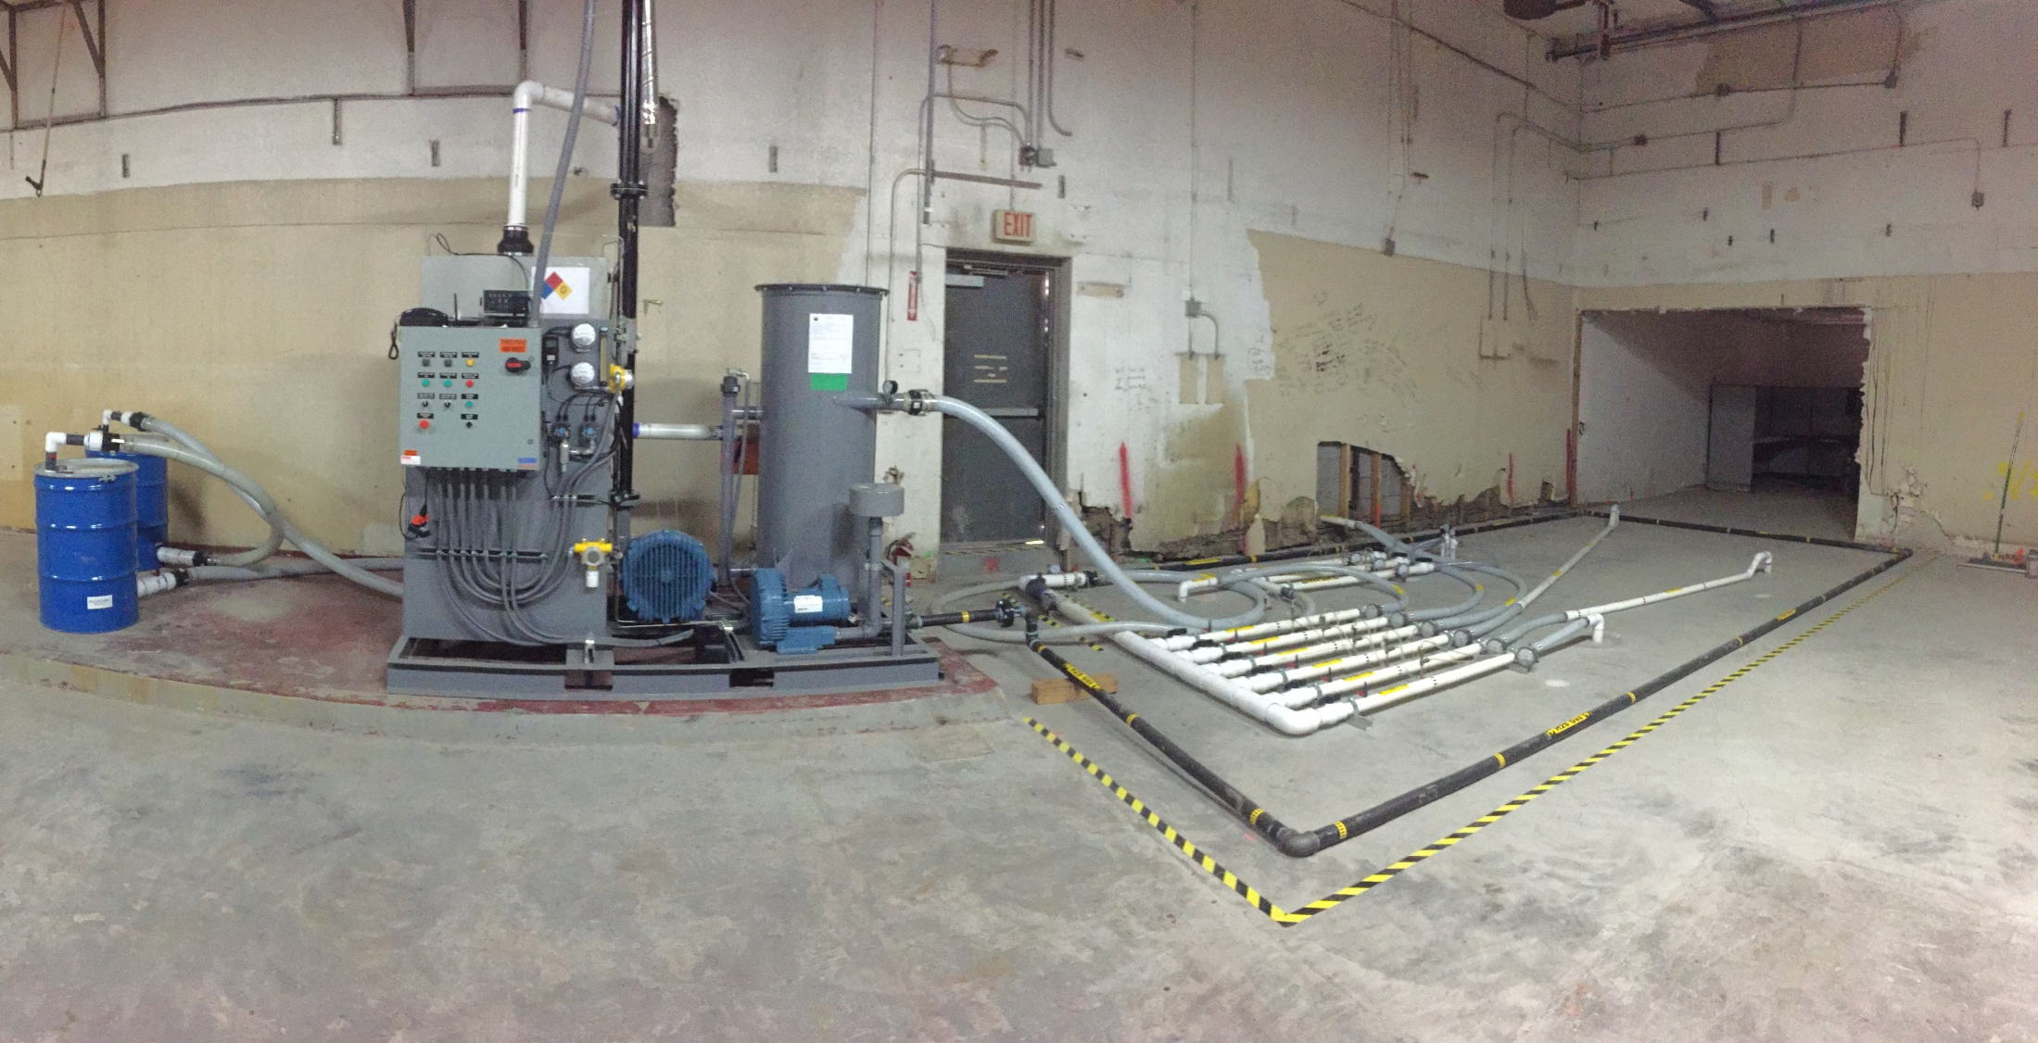
ISGR System Construction

Slide 19
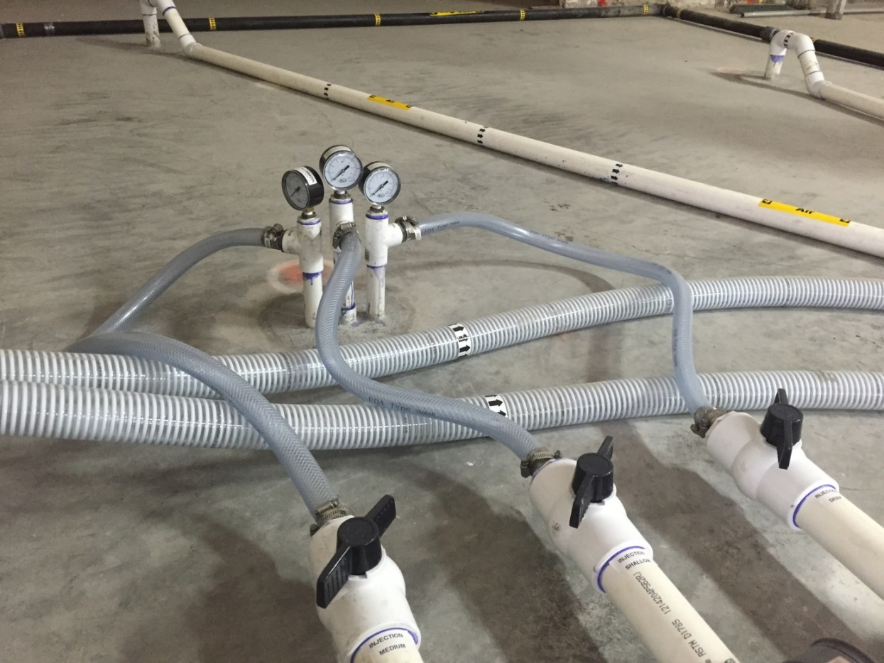
Well Construction
Triple nested injection well to provide improved vertical control of H₂S Distribution
Extraction wells single screened from 10-45’
10-20’
22-32’
34-44’

Slide 20
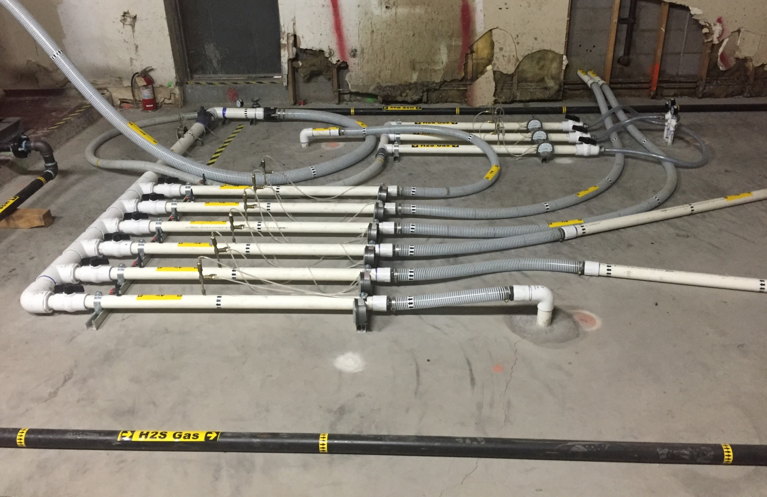
Distribution System

Slide 21
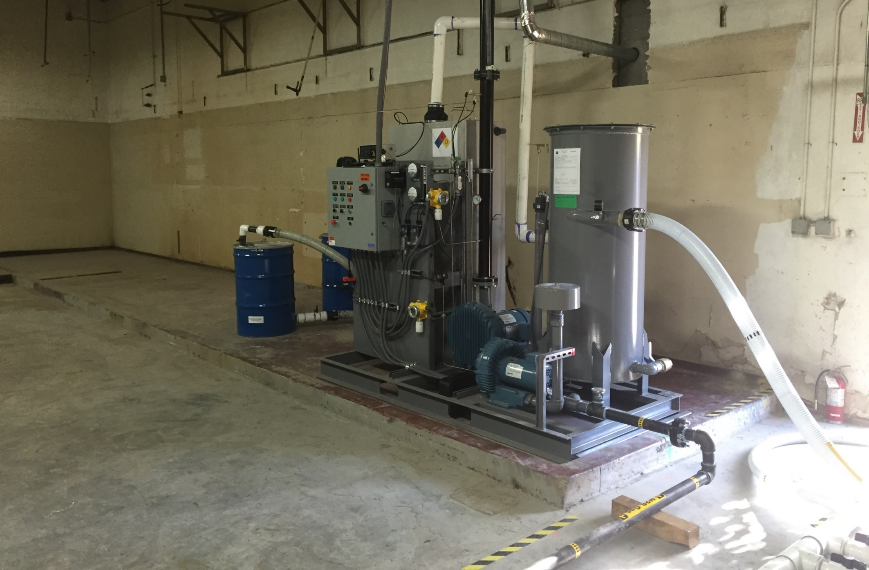
Delivery System

Slide 22
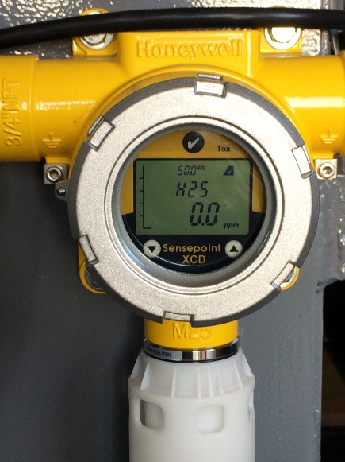
Health and Safety
H₂S Monitoring/Alarms
In gas cabinet (injection stops, extraction continues to maintain negative air flow in cabinet)
In ambient air (full shutdown)
In stack (full shutdown)
Autodialer to Fire Department and 24 hour alarm response team
Backup battery powered monitoring/alarms
Placarding
All cabinet work or alarm response in Level B

Slide 23
Alarm Situation
Autodialer callout on a Sunday afternoon
H₂S detected in Cabinet >10 ppm
Fire department and designated project emergency personnel responded
Fire Department responders not adequately prepared for H₂S, notwithstanding extensive notifications
Alarm in cabinet, but not ambient
Diagnosed as a loose rotameter connection

Slide 24
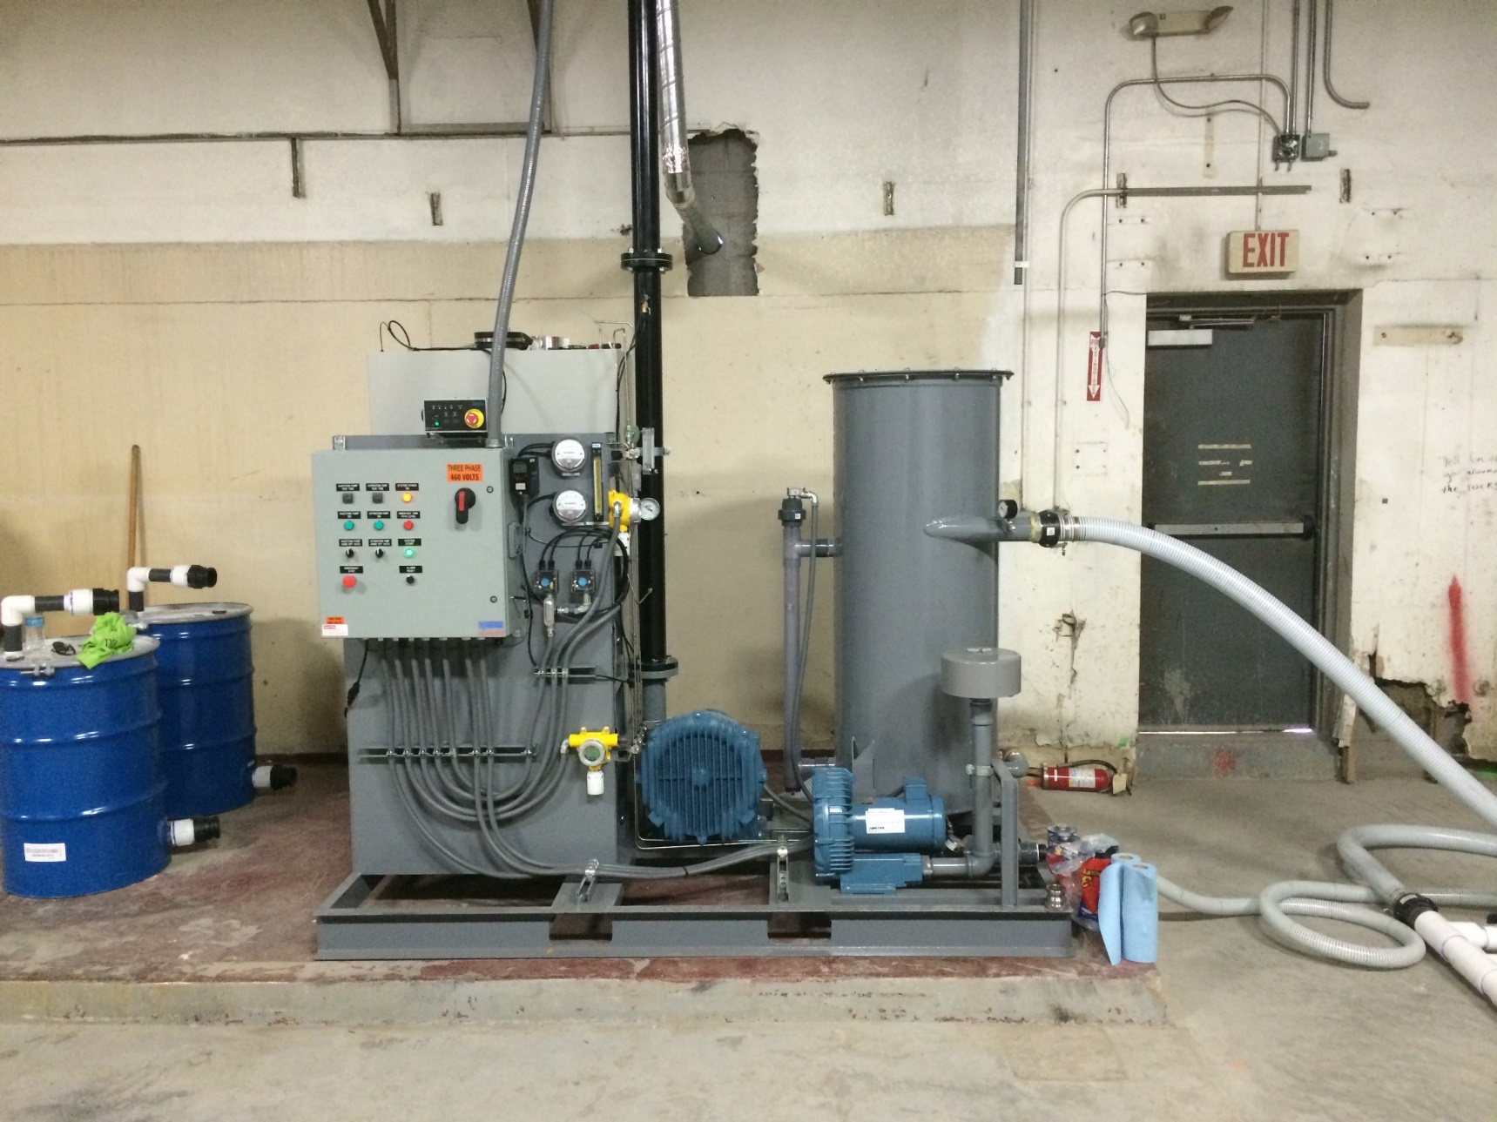
Alarm Diagnosis
Initial Alarm: H₂S drawn into cabinet through louvers
Turning on power to system (gas off, blowers off) caused second ambient air alarm
Due to residual H₂S in feed line, released as solenoids opened
After repair, full leak check with Helium

Slide 25
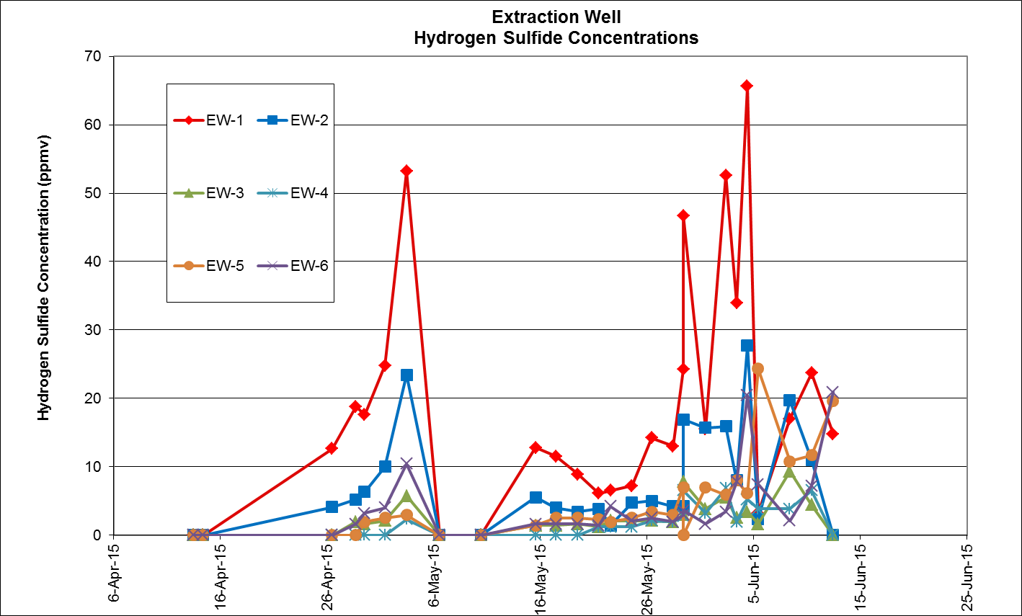
Results!
1
6
2
5
3
4
Preferential Flow Direction

Slide 26
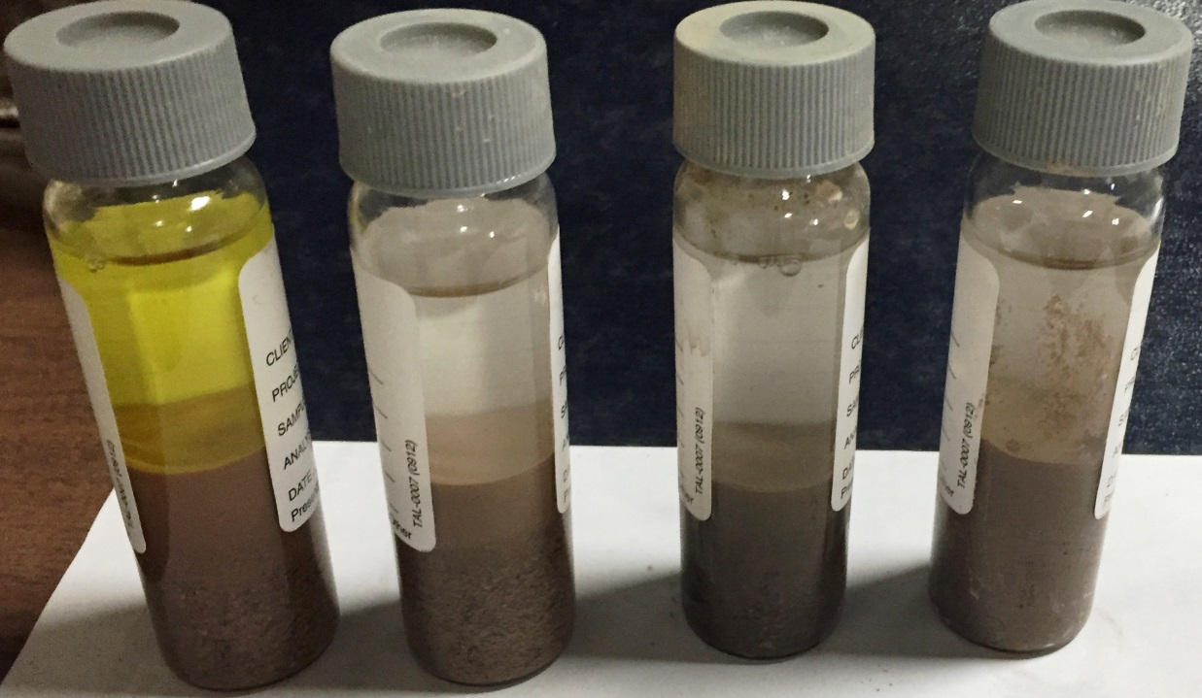
Results!
Samples collected after 8 weeks of injection
Field screening of soils from drill cuttings showed generally good reduction, with pockets of remaining CrVI
12’ 20’ 32’ 38’

Slide 27
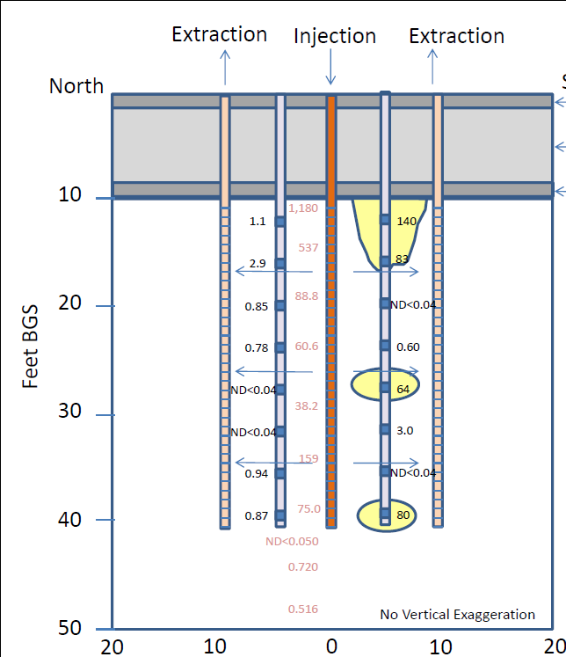
Results!
South
Confirmation results ranged from ND<0.04 mg/kg to 140 mg/kg
95% UCL of post-remediation CrVI concentration:
16.34 mg/kg
98.8% reduction in overall CrVI
1,180
537
88.8
60.6
38.2
159
75.0
ND<0.050
0.720
0.516

Slide 28
ISGR Cost
ISGR treatment of ~410 yards of soil: ~$250,000
Approximately $650/yard
Includes:
Treatment Skid
Well Installation (7 sonic wells)
Permitting
Labor/monitoring
H₂S supply
Post-Treatment Characterization (2 borings)
Unit cost would be reduced for larger-scale implementation

Slide 29
Excavation Cost
Excavation of ~400 yards of shallow soil: ~$230,000
Includes:
Limited access excavation
Confirmation Sampling
Backfill
Re-poured slab
Transport and Disposal (80% RCRA hazardous)

Slide 30
Summary
ISGR treatment achieved CrVI remediation goals quickly and cost-effectively
Non-detect results achieved for CrVI throughout the majority of the treatment area
Implementation is difficult, requiring close oversight and extensive H&S precautions
Scaled up treatment of larger soil volumes will improve cost effectiveness, but will also pose additional H&S concerns with H₂S storage, management, and delivery

Slide 31
Questions?

